Slide 1


Social Buzz

Slide 2


Today's agenda
Project recap
Problem
Process
Insights
Summary

Slide 3

Social Buzz is a rapidly growing tech unicorn with over 500 million users monthly that needs help to adapt to its massive global reach. Started in 2008, the app was created with an aim to revolutionize social media norms by focusing more on the content itself rather than the user hence giving content the center stage.
Accenture has started a 3-month proof of concept focusing on three key areas:
-Auditing Social Buzz's big data practices
-Providing recommendations for a successful IPO -Analyzing data to identify the company's most popular categories, content types and their trends.
Project Recap

Slide 4

Problem
Over 100,000 posts daily which means
36,500,000 pieces of content per year!
-How does the business know what to
capitalize on when there is so much data
involved?
Solution: A thorough analysis of the data to
know the most popular categories and
and their trends through the year.

Slide 5
Process
1
Data Understanding
2
Data Cleaning
3
Data Modelling
4
Data Analysis
5
Insights

Slide 6
Data Understanding
Social Buzz provided us with three datasets containing the content, reactions and reaction types.
Initially, the Content dataset had 6 columns namely; unnamed:0, User ID, Content ID,
Type, Category, URL . The Reaction dataset had 5 columns namely; unnamed: 0 , User ID , Type and Datetime. And the Reaction type dataset had 4 columns namely: Unnamed:0, Type, Sentiment, Score.
From the three datasets , we are able to get the information required to meet our deliverables, however this is only possible after cleaning and modelling the data which takes us to the next step.

Slide 7
Data Cleaning
During the Data Cleaning process, we focused on removing unnecessary and missing data values from the three datasets to enhance their efficiency for subsequent analysis.
Initially, the Content dataset contained 1000 entries and 6 columns. We removed two columns: URL and Unnamed: 0. Similarly, the Unnamed: 0 columns were removed from the Reactions and Reactions Type datasets. Additionally, any missing values were eliminated. As a result, the datasets are now clean and ready for data modeling.

Slide 8
Data Modeling
In the Data Modeling step, we structured the data to optimize it for subsequent analysis.
We merged the three datasets into a single comprehensive dataset and introduced a new column to record the month, enabling us to monitor trends throughout the year. For clarity, we renamed the 'Type' column in the Content dataset to 'Content Type' and the 'Type' column in the Reaction Types dataset to 'Reaction Type’.
This reorganization ensures precise identification and enhances the overall efficiency of our data analysis process.

Slide 9
Insights
In this section, we present the insights derived from the provided data. Various visualization techniques, including charts and graphs, are employed to effectively convey these insights.
In this section we answer the following questions:
What are the top 5 categories?
What is the distribution of categories?
What are the top content types?
What is the distribution of content types?
What are the most common reaction types?
What is the trend of the top categories?
What is the trend of the various content types?
What is the correlation between content types and reaction types?
What is the distribution of sentiments over time?
What are the average scores per content type?

Slide 10
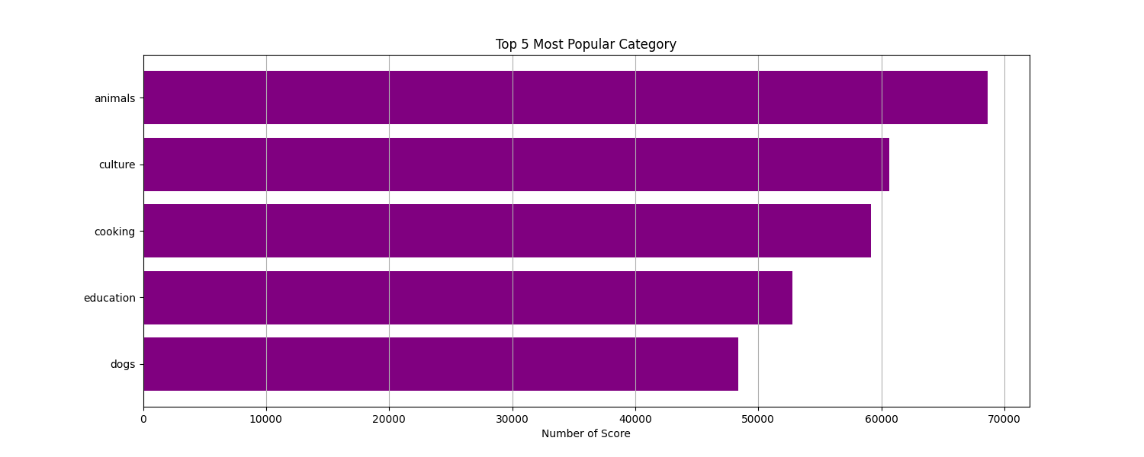
What are the top 5 most popular categories?
This bar graph reveals that the top categories based on scores, in descending order, are Animals, Culture, Cooking, Education, and Dogs.

Slide 11
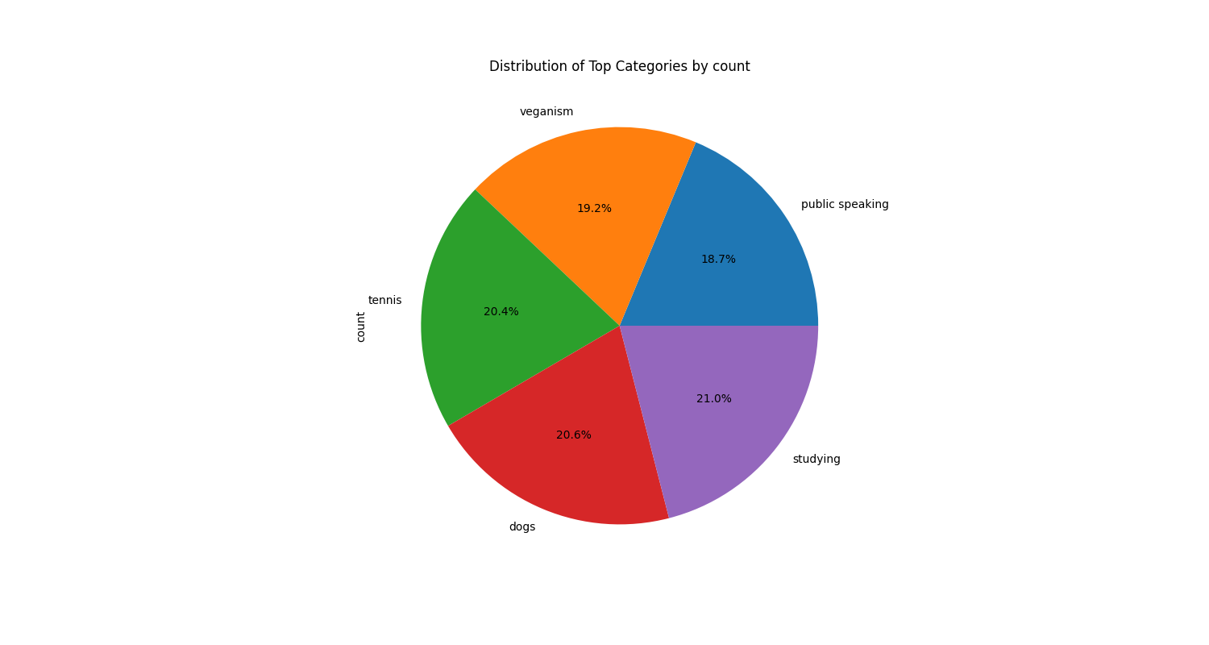
What is the distribution of categories?
The distribution of the top categories based on their count , in descending order, are Studying , Dogs, Tennis, Veganism, Public Speaking.

Slide 12
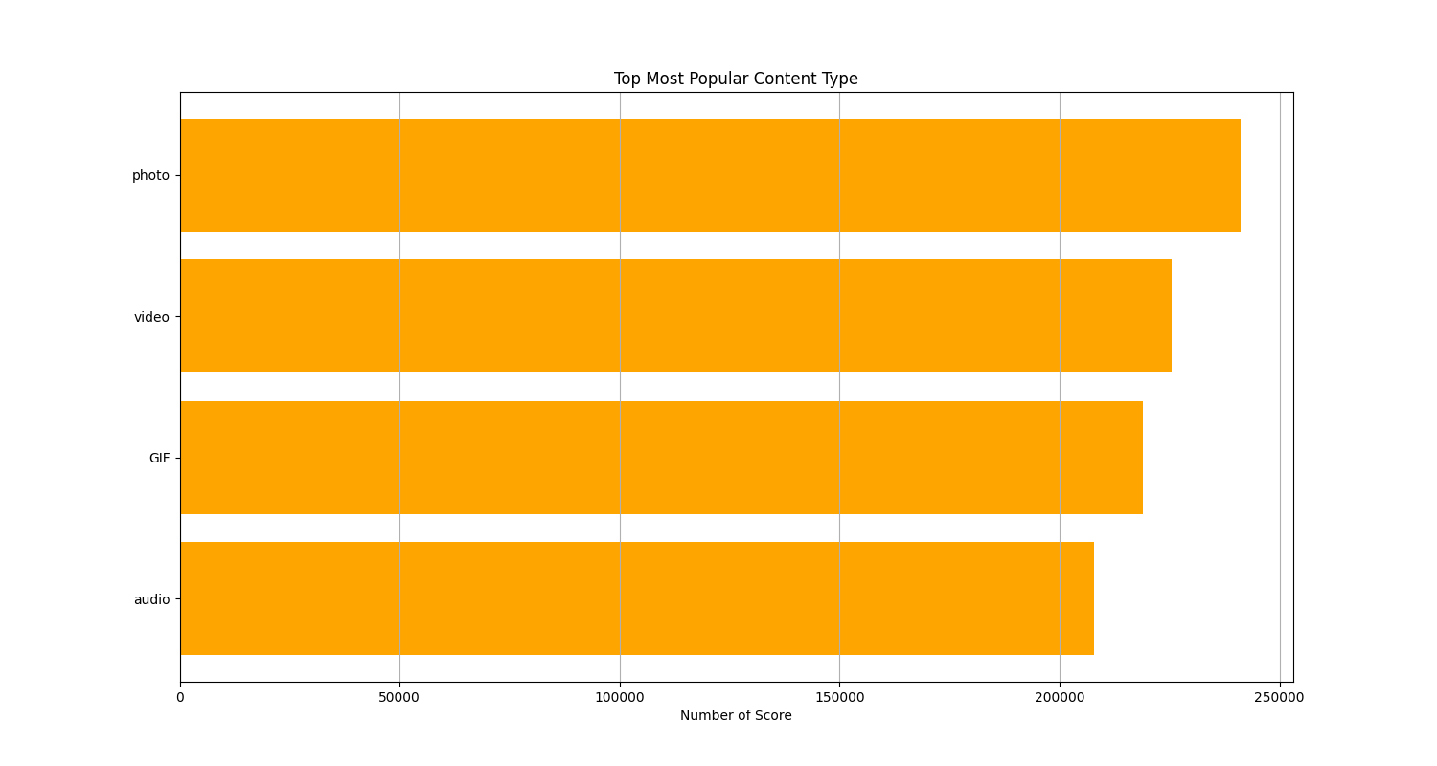
What are the top content types?
The distribution of content type by Score is Photo, Video, GIF, Audio, in descending order

Slide 13
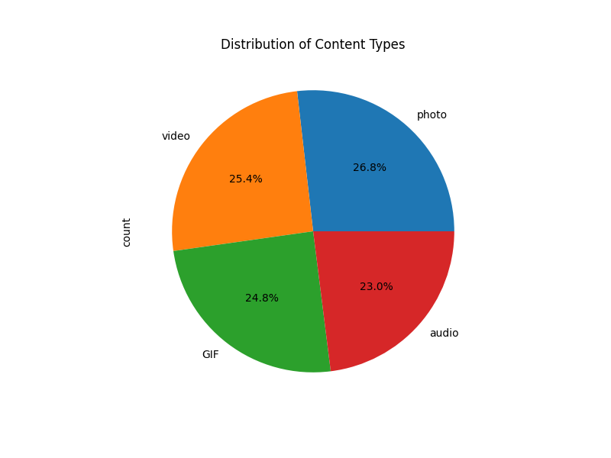
What is the distribution of content types?
The distribution of content types by count is Photo, Video, GIF, Audio , in that descending order

Slide 14
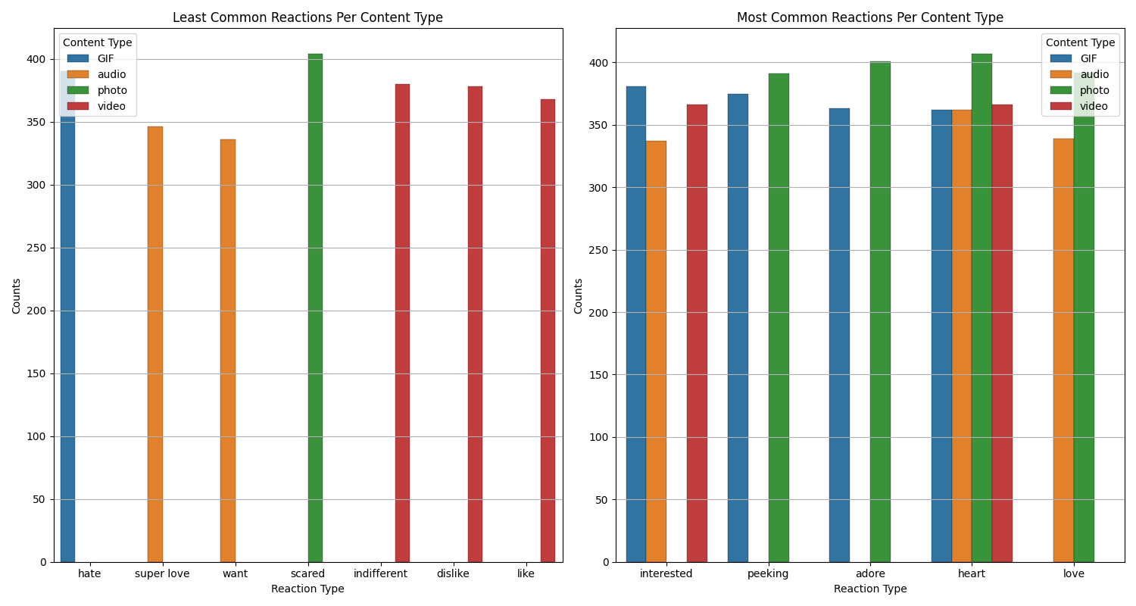
What are the most common reaction types?
The most common reaction types are ‘interested’, ’peeking’, ‘adore’, ‘heart’, ‘love’ while the least common are ‘hate’, ‘super love’, ‘want’, ‘scared’, ‘indifferent’, ‘dislike’ and ‘like’.

Slide 15
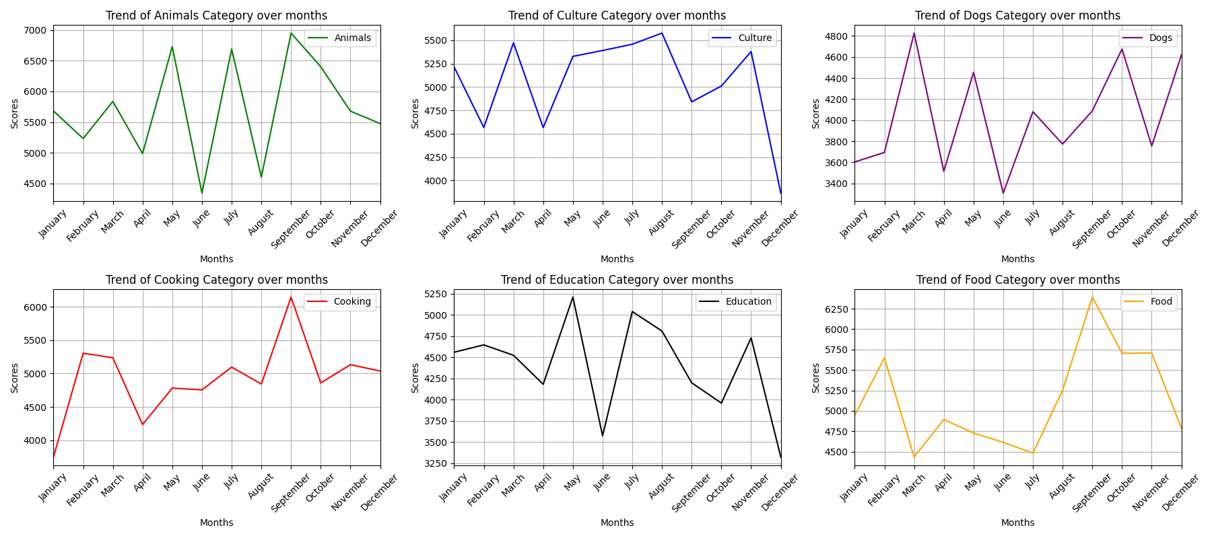
What is the trend of the top categories?

Slide 16
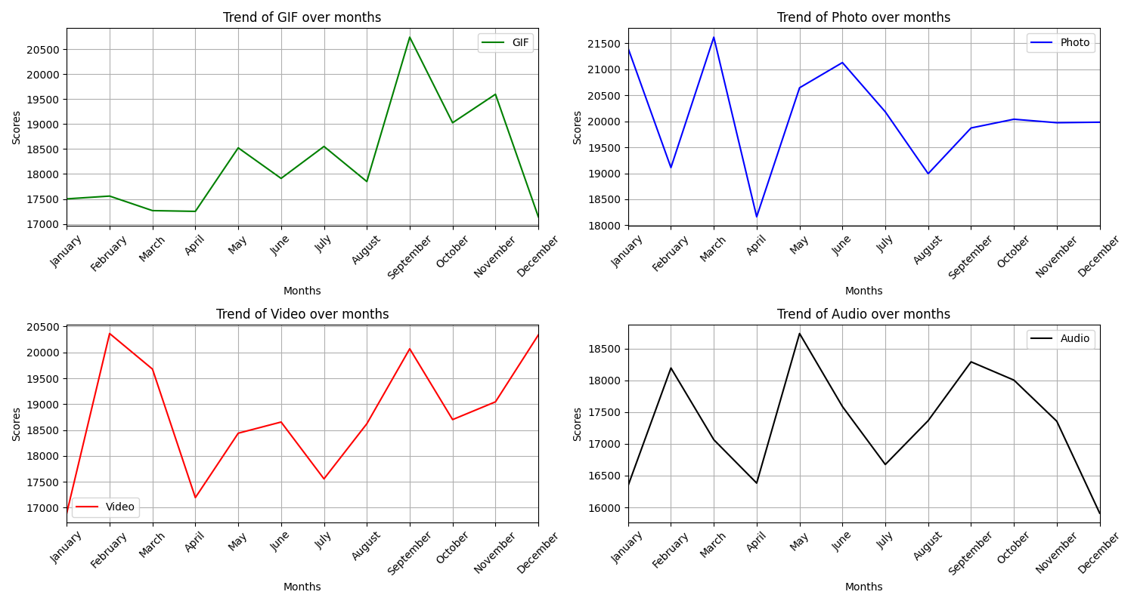
What is the trend of various content types?

Slide 17
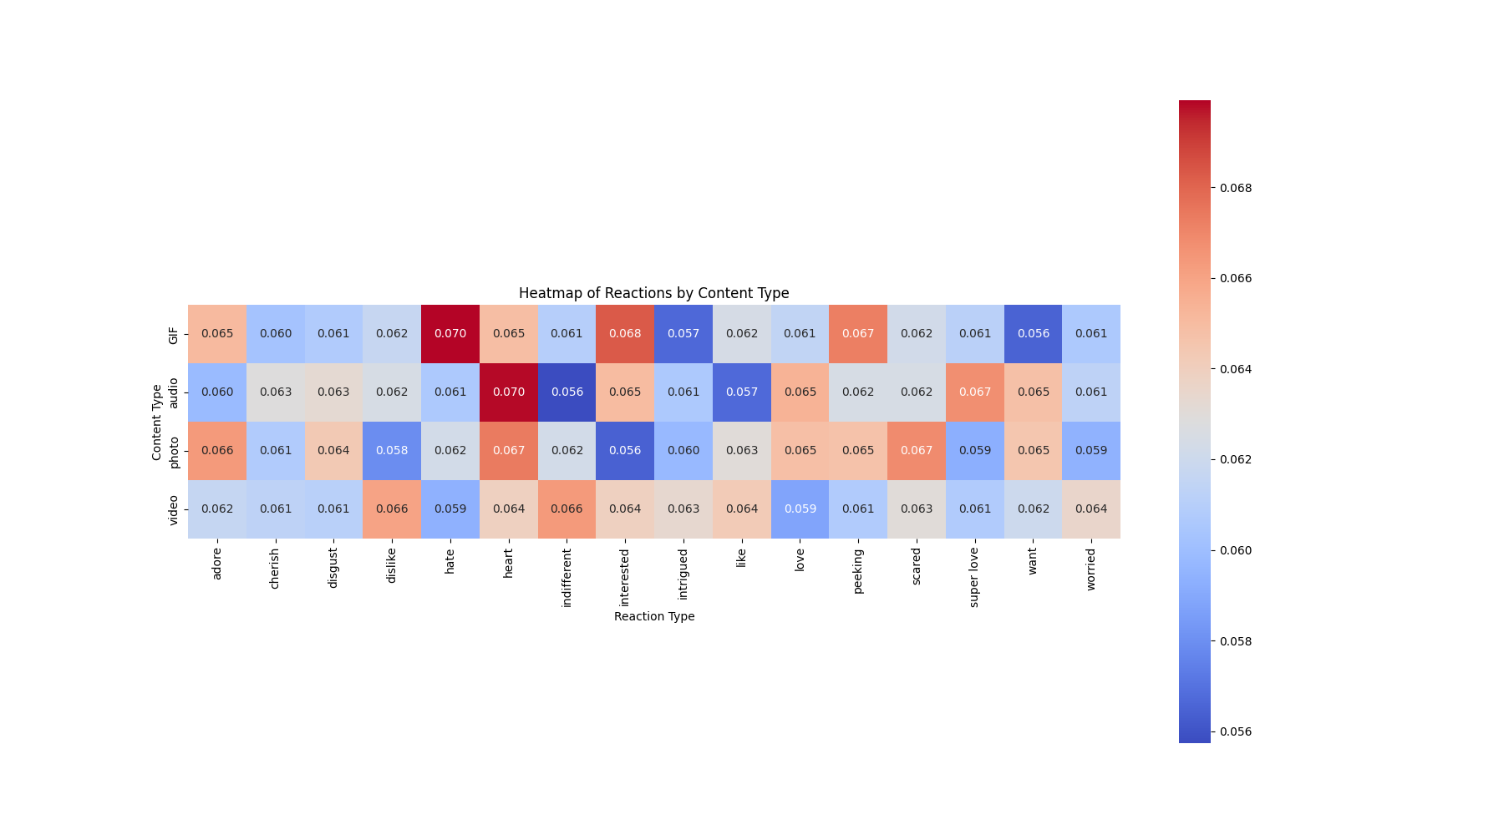
What is the correlation between content types and reaction types?

Slide 18
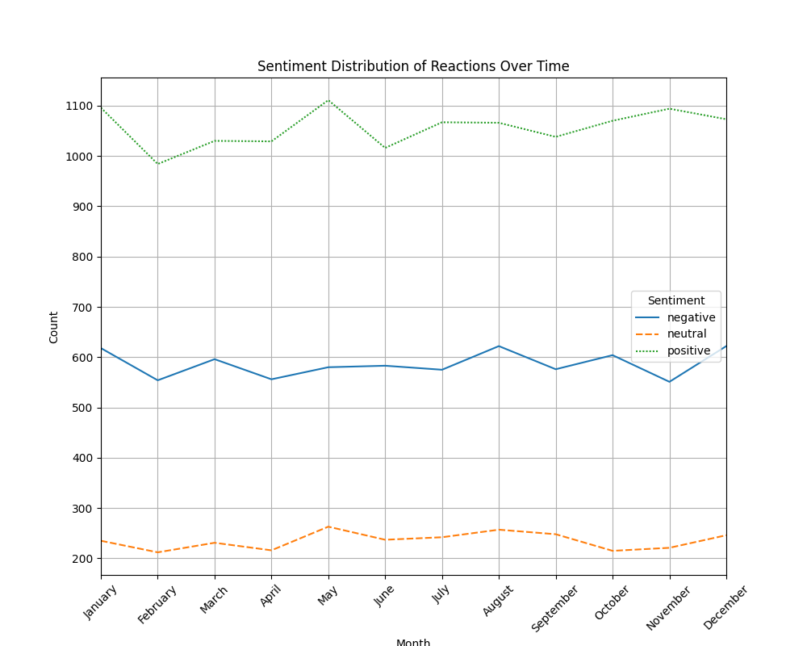
What is the distribution of sentiments over time?

Slide 19
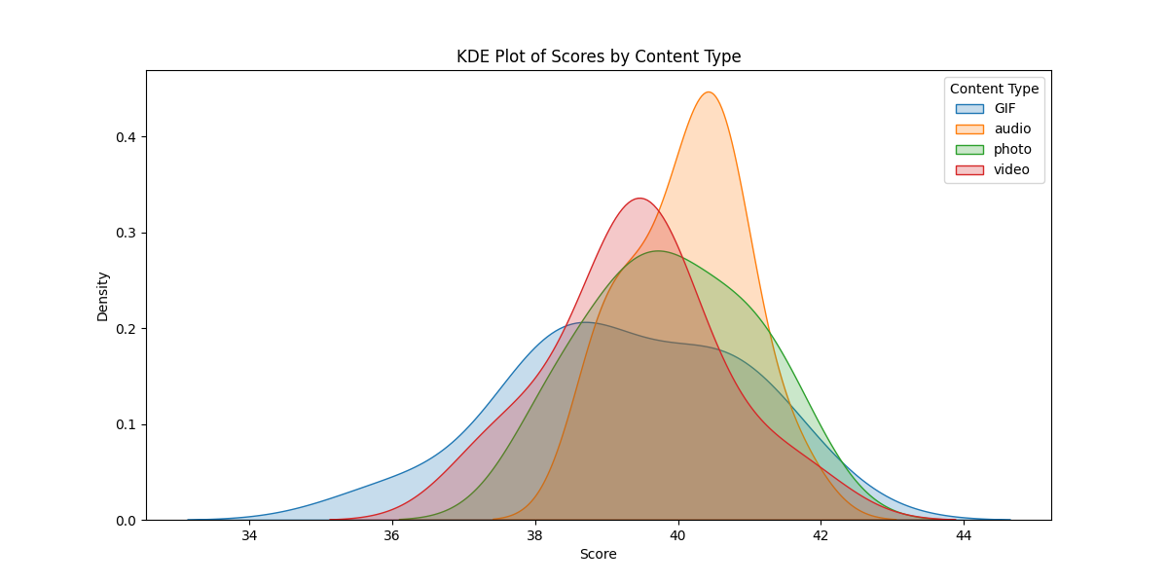
What are the average scores per content type?

Slide 20

CONCLUSIONS
The top categories based on scores, in descending order, are Animals, Culture, Cooking, Education, and Dogs.
The distribution of the top categories based on their count , in descending order, are Studying , Dogs, Tennis, Veganism, Public Speaking.
The distribution of content type by Score is Photo, Video, GIF, Audio, in descending order.
The distribution of content types by count is Photo, Video, GIF, Audio , in that descending order.
The most common reaction types shared between content types are ‘interested’, ’peeking’, ‘adore’, ‘heart’, ‘love’ while the least common are ‘hate’, ‘super love’, ‘want’, ‘scared’, ‘indifferent’, ‘dislike’ and ‘like’.

Slide 21

In this presentation, we explored the comprehensive analysis of Social Buzz's data, focusing on optimizing their big data practices, preparing for a successful IPO, and identifying the top-performing categories.
Through rigorous data cleaning and modeling, we ensured the datasets were accurate and efficient for analysis. Various visualizations highlighted key insights. Our audit and recommendations provide a clear pathway for enhancing Social Buzz's data strategy and business performance.
Summary

Slide 22
Thank you!
Thank you for your attention. We look forward to discussing our findings and recommendations further.
ANY QUESTIONS?

